Slide 1

Spotify Users Analysis
-Presented By
DEEKSHA R

Slide 2

PROJECT INTRODUCTION
This project aims to analyze and understand the behavior of Spotify users based on a comprehensive dataset. By exploring user demographics, subscription plans, preferred content, and listening habits, we seek to uncover insights that can help improve Spotify's service and tailor it to the preferences of its diverse user base. Through data analysis and visualization, we aim to enhance user experience and inform strategic decisions in the music streaming industry.

Slide 3
IMplementation of project
Define and Plan ----> Analysis -----> Present & Document
1. Define and Plan: This step involves understanding the project's goals, objectives.
2. Analysis: This step involves collecting and preprocessing data, exploring and understanding the dataset.
3. Present and Document: This step involves documenting the project's process and creating a presentation or report to communicate the findings and outcomes.

Slide 4
DESCRIPTION OF DATASET
The Spotify Users dataset provides information into the music preferences and behavior of Spotify's users. It includes a variety of attributes such as age, gender, subscription plan, preferred listening device, and music listening habits. This dataset offers valuable information for understanding user engagement , and the impact of subscription plans on user behavior

Slide 5
Data Pre-processing
First step ,the data was loaded and read into python using pandas library.
Statistically summary to know about the aggregation values
Identifying missing values
Data Imputation with the help of modal value as it is best suited for categorical data type

Slide 6

TEMPLATE
Created a template for dashboard using Figma in accordance with
the charts for visualizing and better understanding.

Slide 7
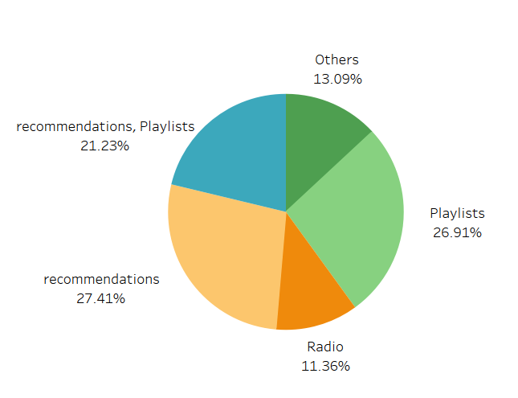
What are the sources of exploration for new music?
Most people find new music through recommendations and next highest is through playlists. Least preferred method is Radio

Slide 8
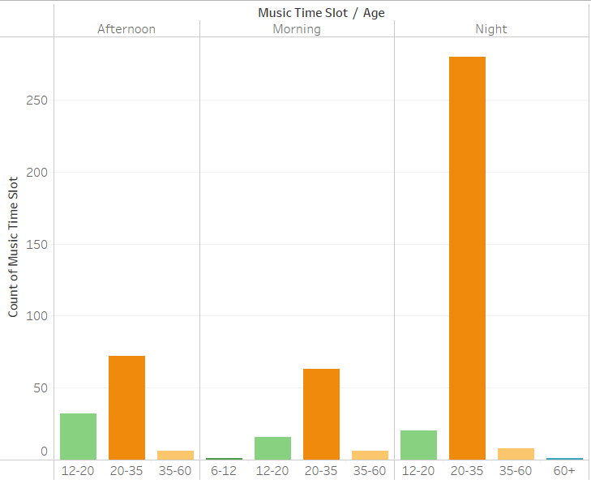
What is the most preferred time slot to listen to music in relation with different age groups?
Night is the most common time slot for listening to music. and people in the age group of 20-35 listens more in this time slot when compared to other age groups

Slide 9
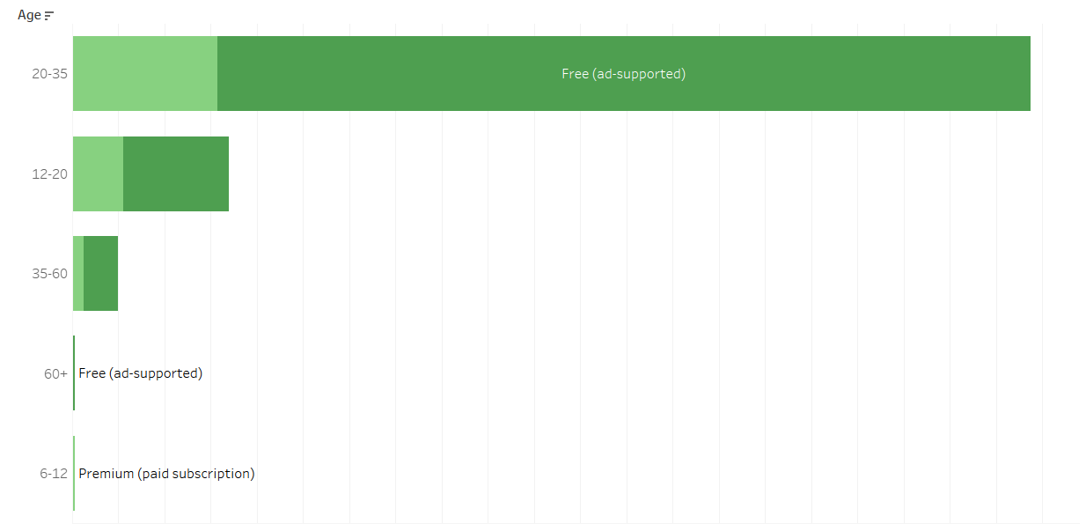
Users of Spotify subscriptions according to age groups
Age group 20-35 are the most listeners and in that, users without subscription are using it more than premium users

Slide 10
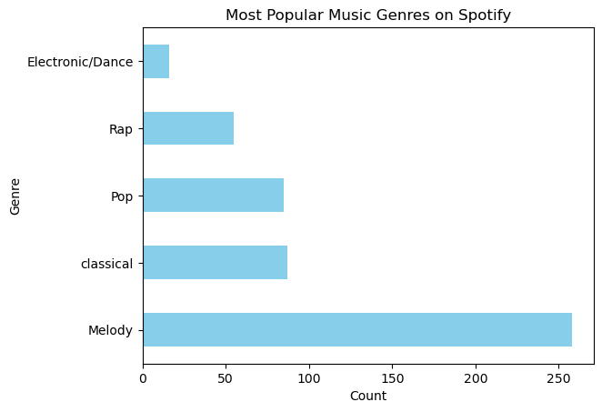
What is the distribution of user preferences for specific music genres?

Slide 11
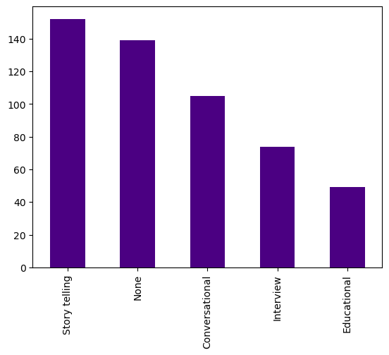
Which podcast formats are more popular among users?

Slide 12
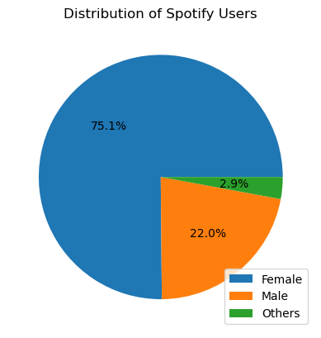
Which category of people use Spotify the most?

Slide 13
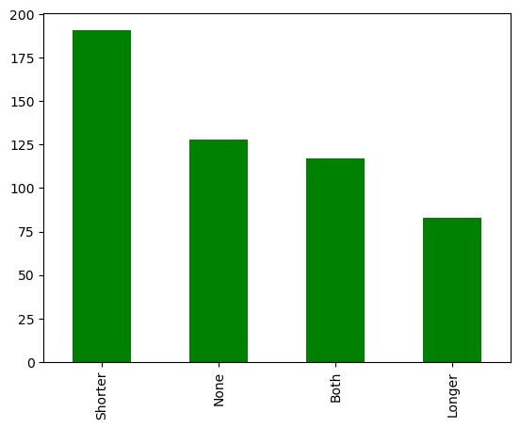
Do users prefer shorter or longer podcast episodes?

Slide 14
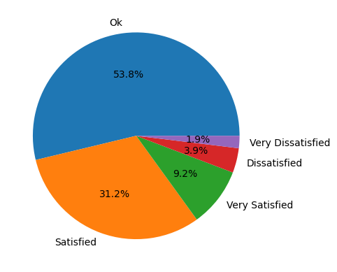
Are users satisfied with the variety and availability of podcasts on Spotify?

Slide 15
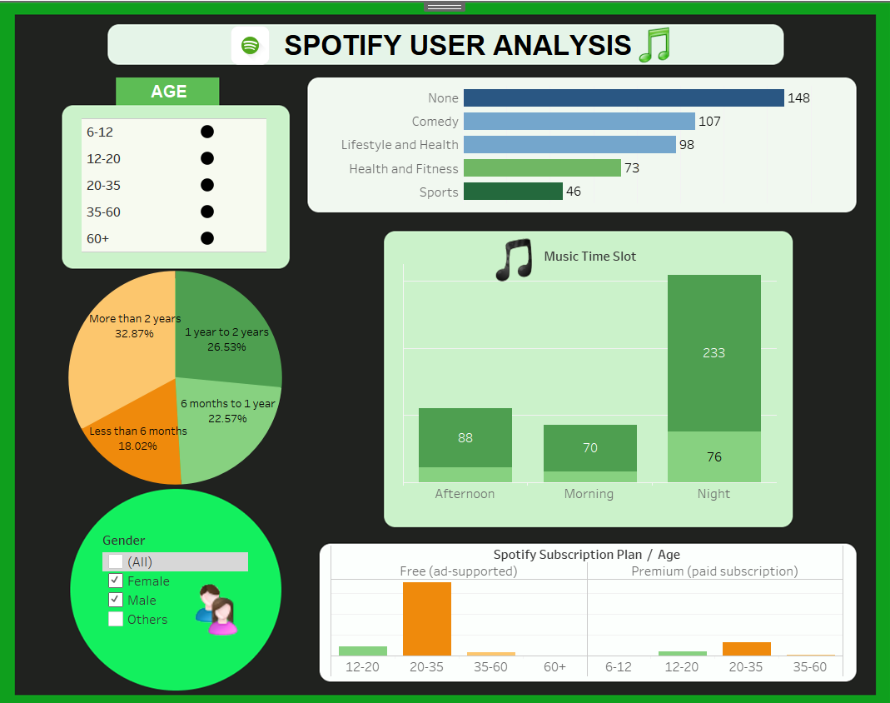
DASHBOARD

Slide 16
FINAL FINDINGS
Content Preferences:
Most Users prefer to listen to music over podcasts.
While traveling is the most frequent occasion for music listening.
Subscription Plan Analysis:
Most of the females are using 'free plan' in comparison to 'Male' and 'Others'.
Most people around 81% use free version with ads and does not use premium account subscription
Demographic Analysis:
Maximum number of the users are in the age group of 20-35 .
Maximum number of the users are mostly females.

Slide 17
FINAL FINDINGS
Content Preferences:
Melody Music genre is the most preferred music.
Most people listen to music for relaxation and relieving stress their mood
Listening time in a Day Analysis:
Podcast listening frequency varies, with the most common frequency being "rarely".
Many users did not give their fav genre of podcast
Maximum number of people like shorter podcasts and rate 'ok' for the variety and availability of podcasts.
Listening time in a Day Analysis:
Most of the people listen music/podcast at night.
Most of the people rate Spotify recommendations as '3 out of 5'.

